Slide 1

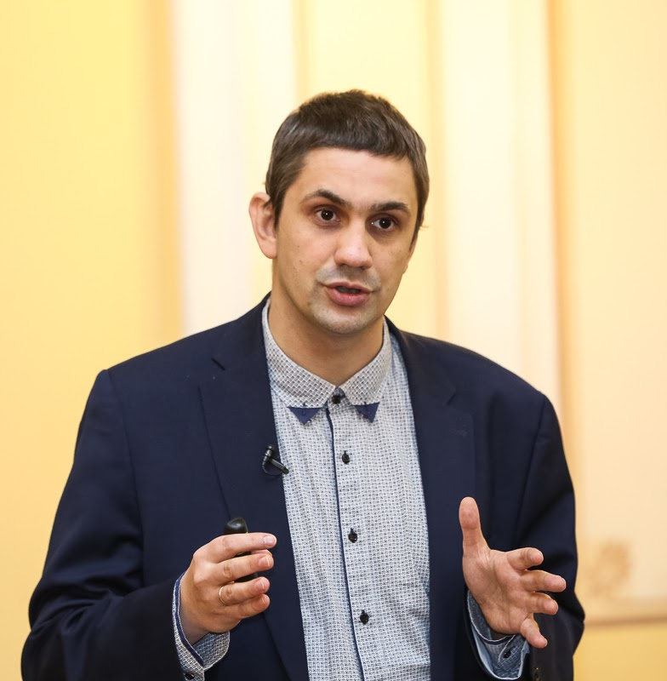
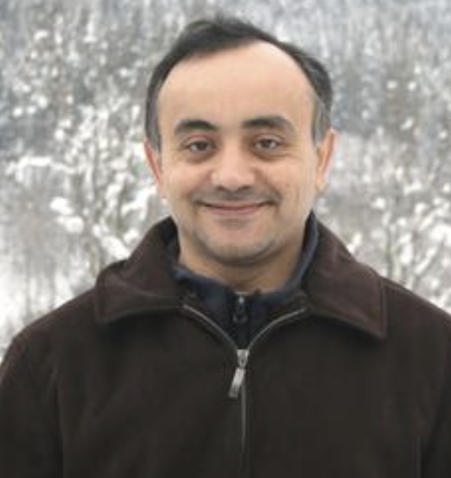


A cascade of two travelling waves for the two-layer model of “gravitational fingering”
Yulia Petrova PUC-Rio, Rio de Janeiro, Brazil
yulia-petrova.github.io
27 August 2024
Sergey Tikhomirov
PUC-Rio
Yalchin Efendiev Texas A&M
Based on joint work with Sergey Tikhomirov, Yalchin Efendiev :
“Propagating terrace in a two-tubes model of gravitational fingering”, 2024, ArXiv: 2401.05981

Slide 2
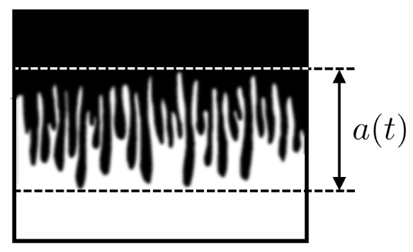
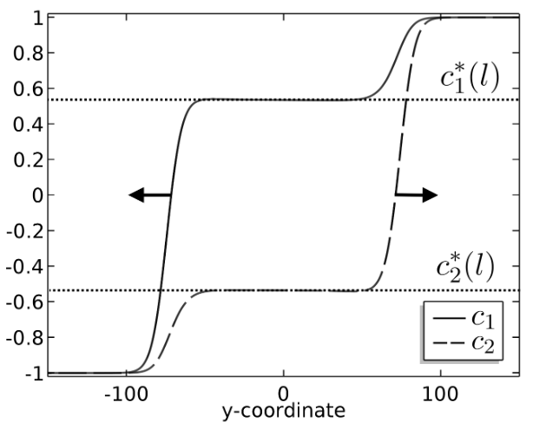
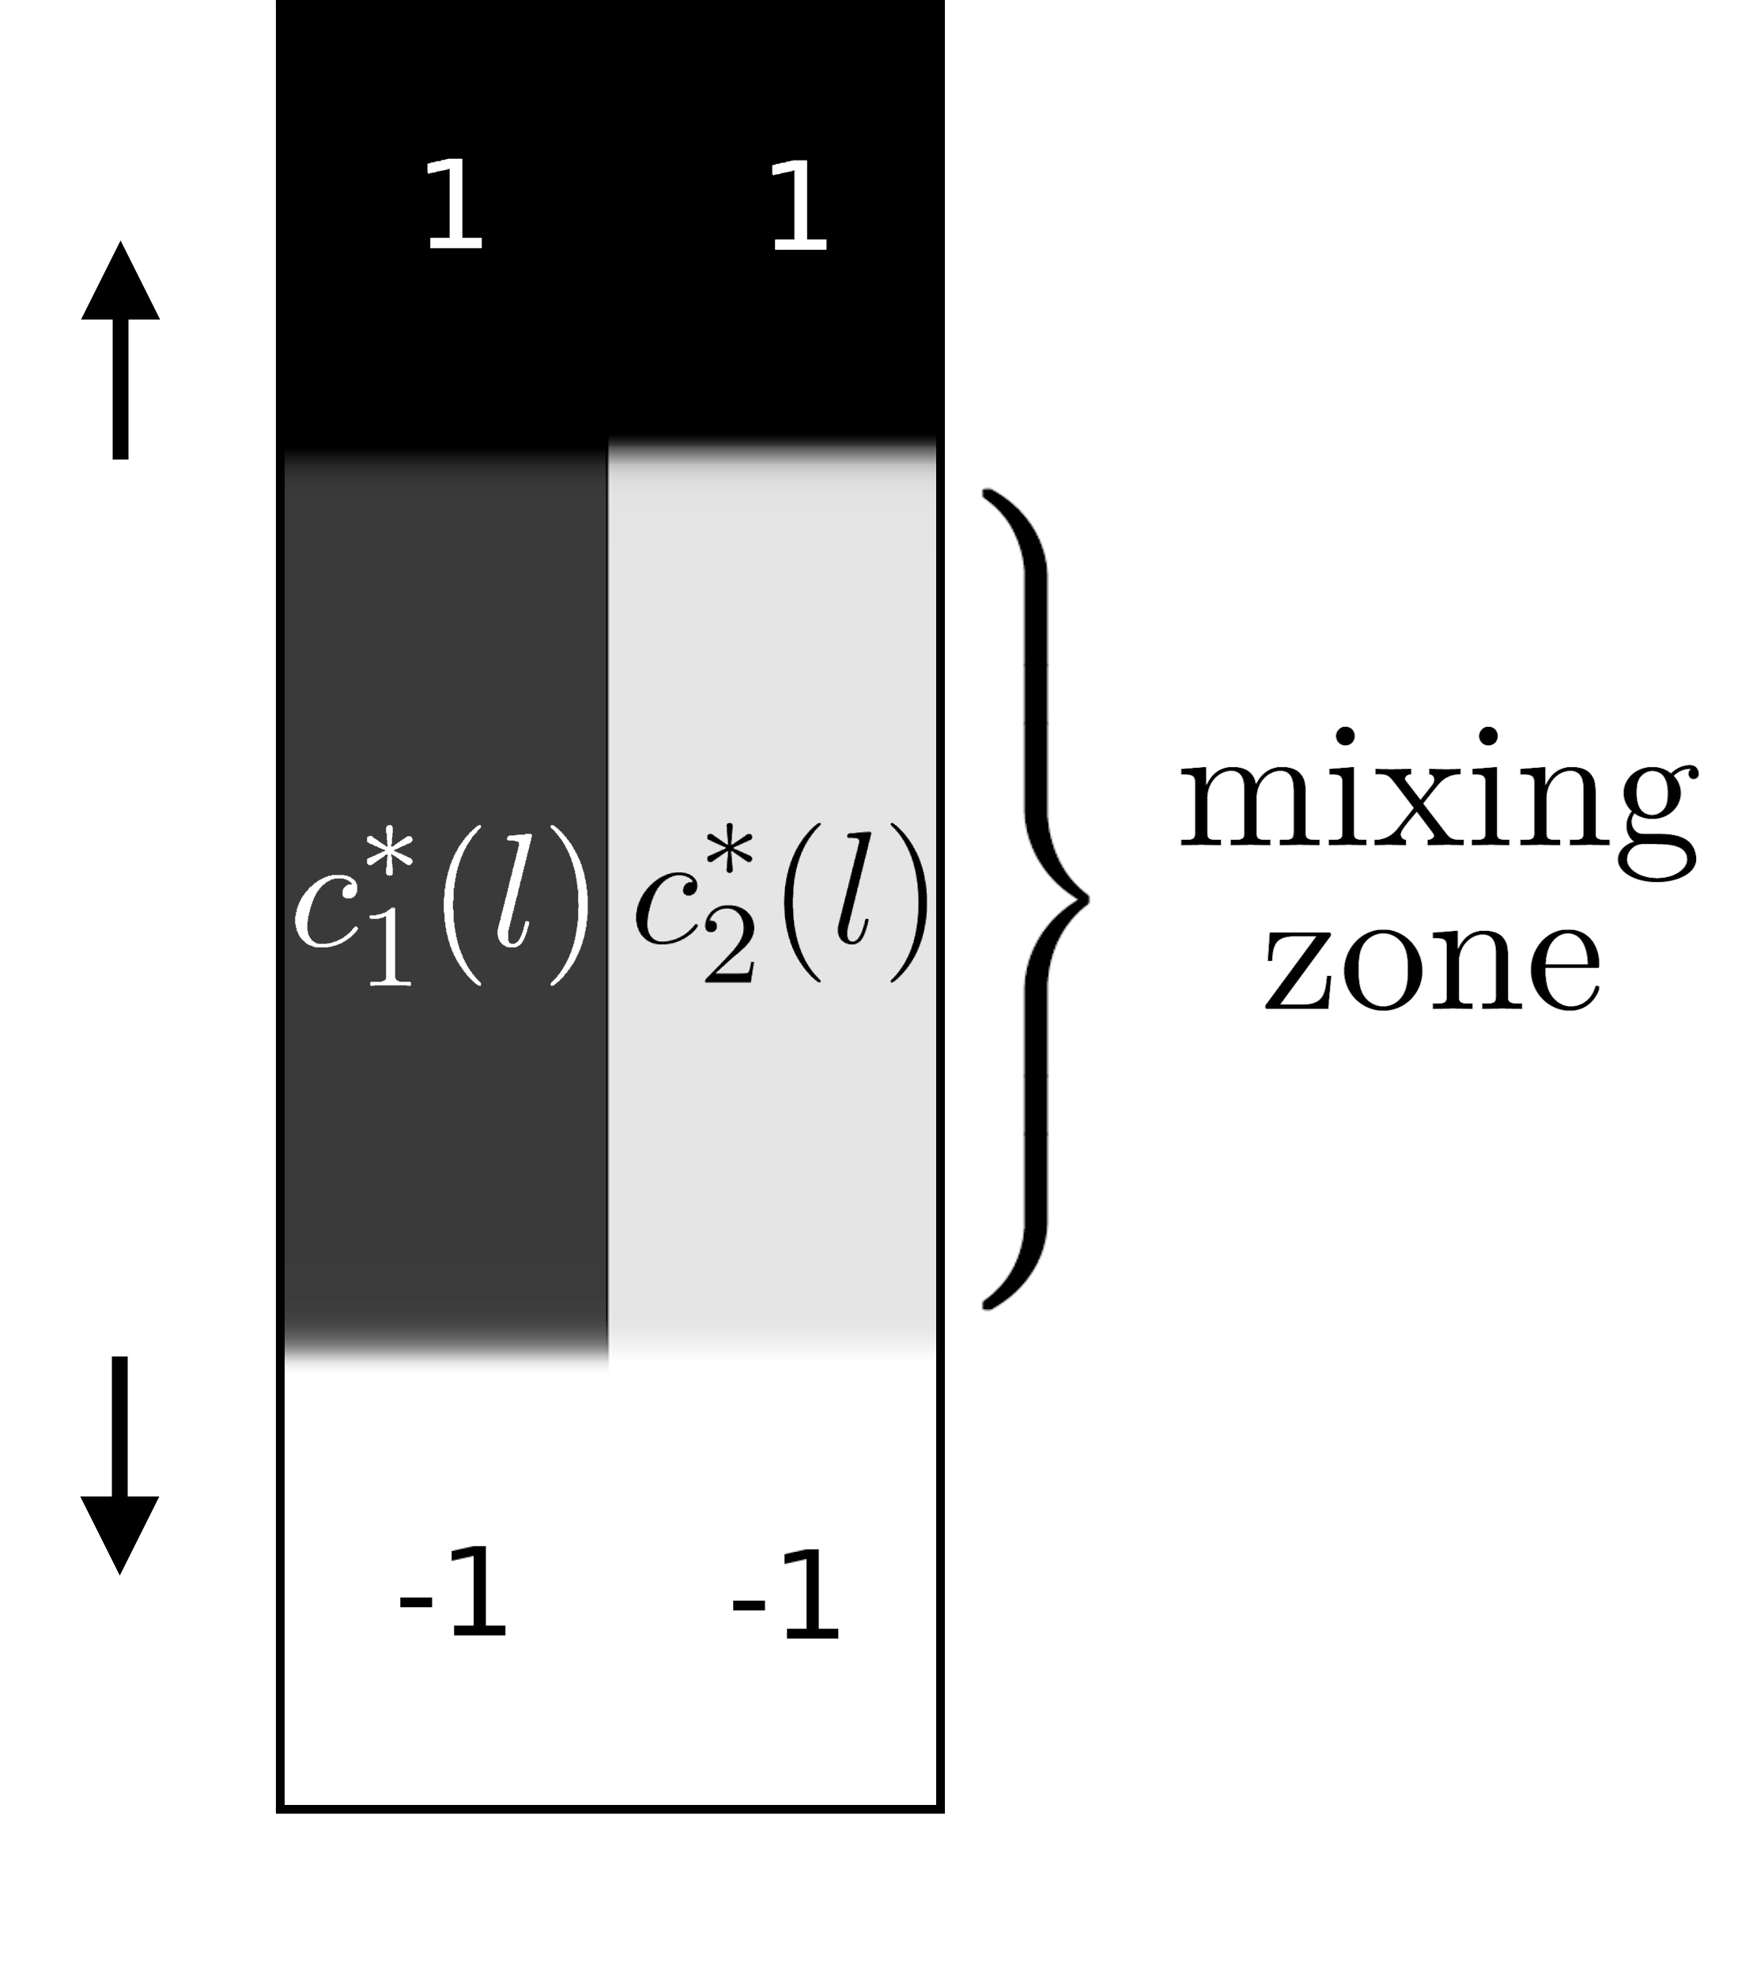
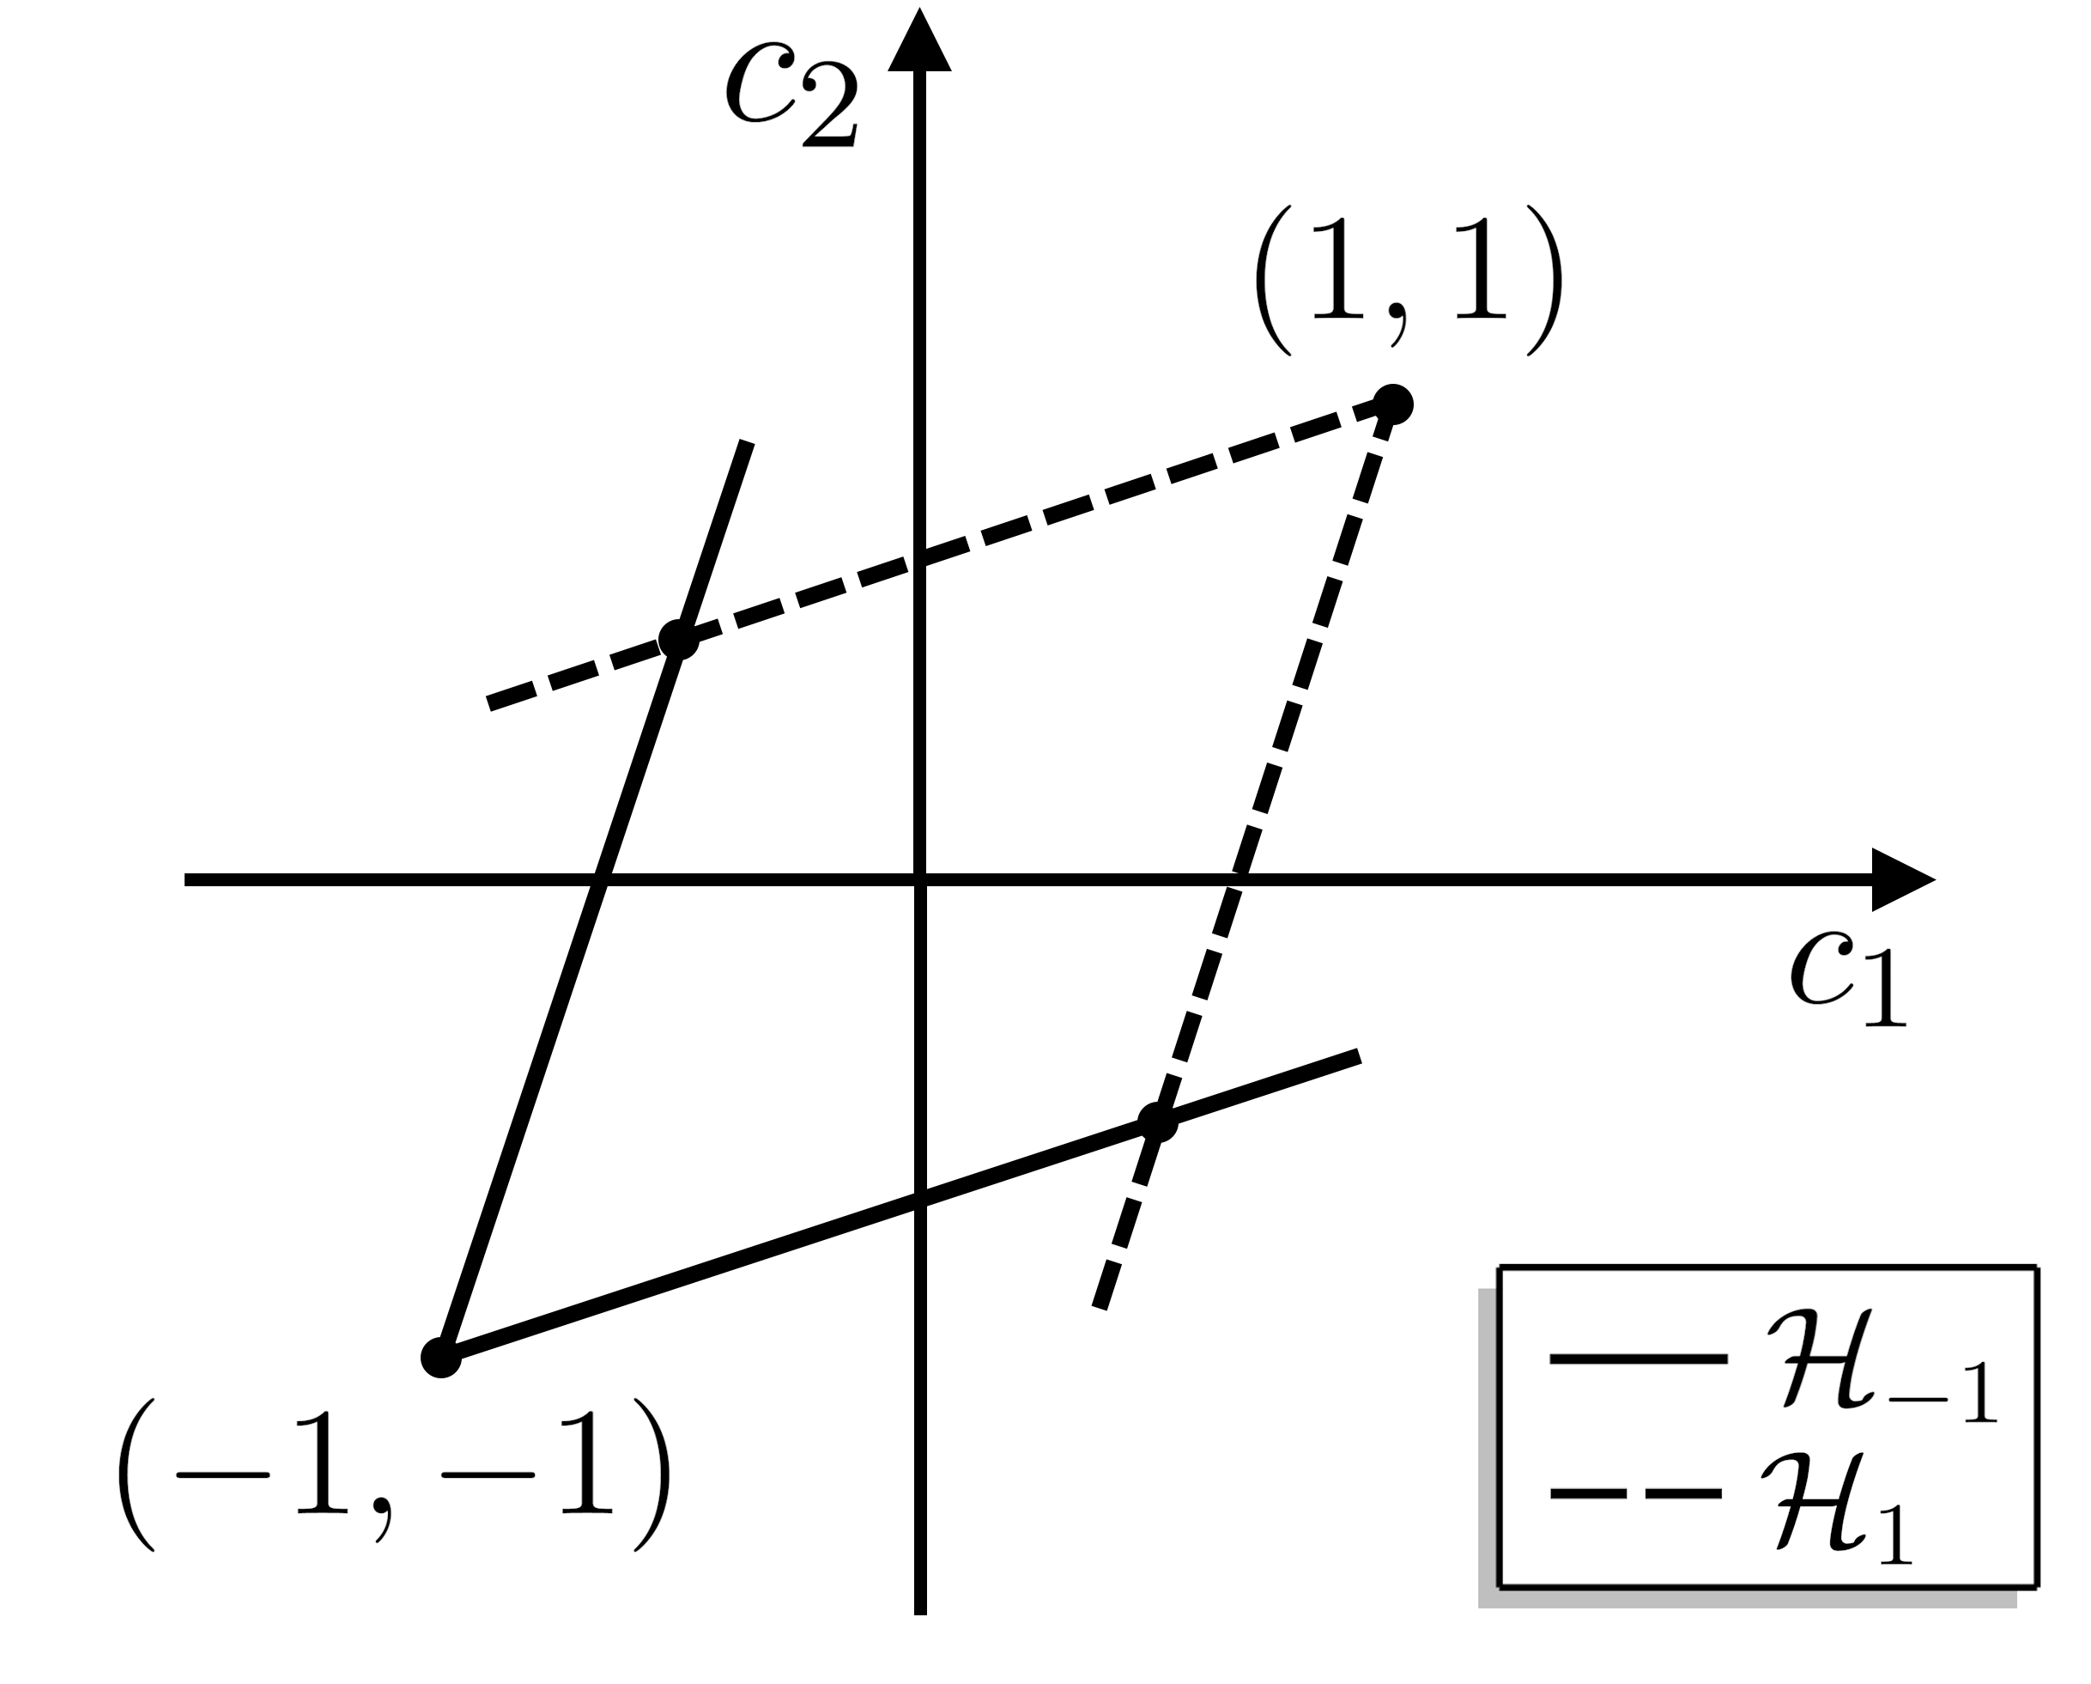
Outline
Motivation
Miscible displacement in porous media
viscous fingering
gravitational fingering
Problem statement
Two-tubes model
Main theorem
Sketch of proof:
traveling waves
slow-fast systems

Slide 3
“Miscible displacement in porous media”
Credit: Pavlov Dmitrii, St. Petersburg State University
Homsy , 1987 “Viscous Fingering in Porous Media”
Viscous fingering phenomenon
water (blue color) polymerized water (red color)
1

Slide 4
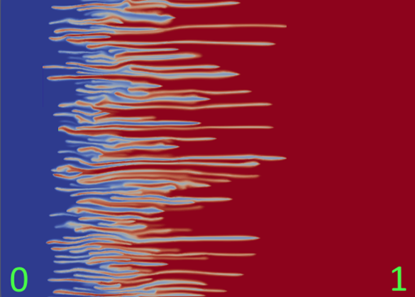
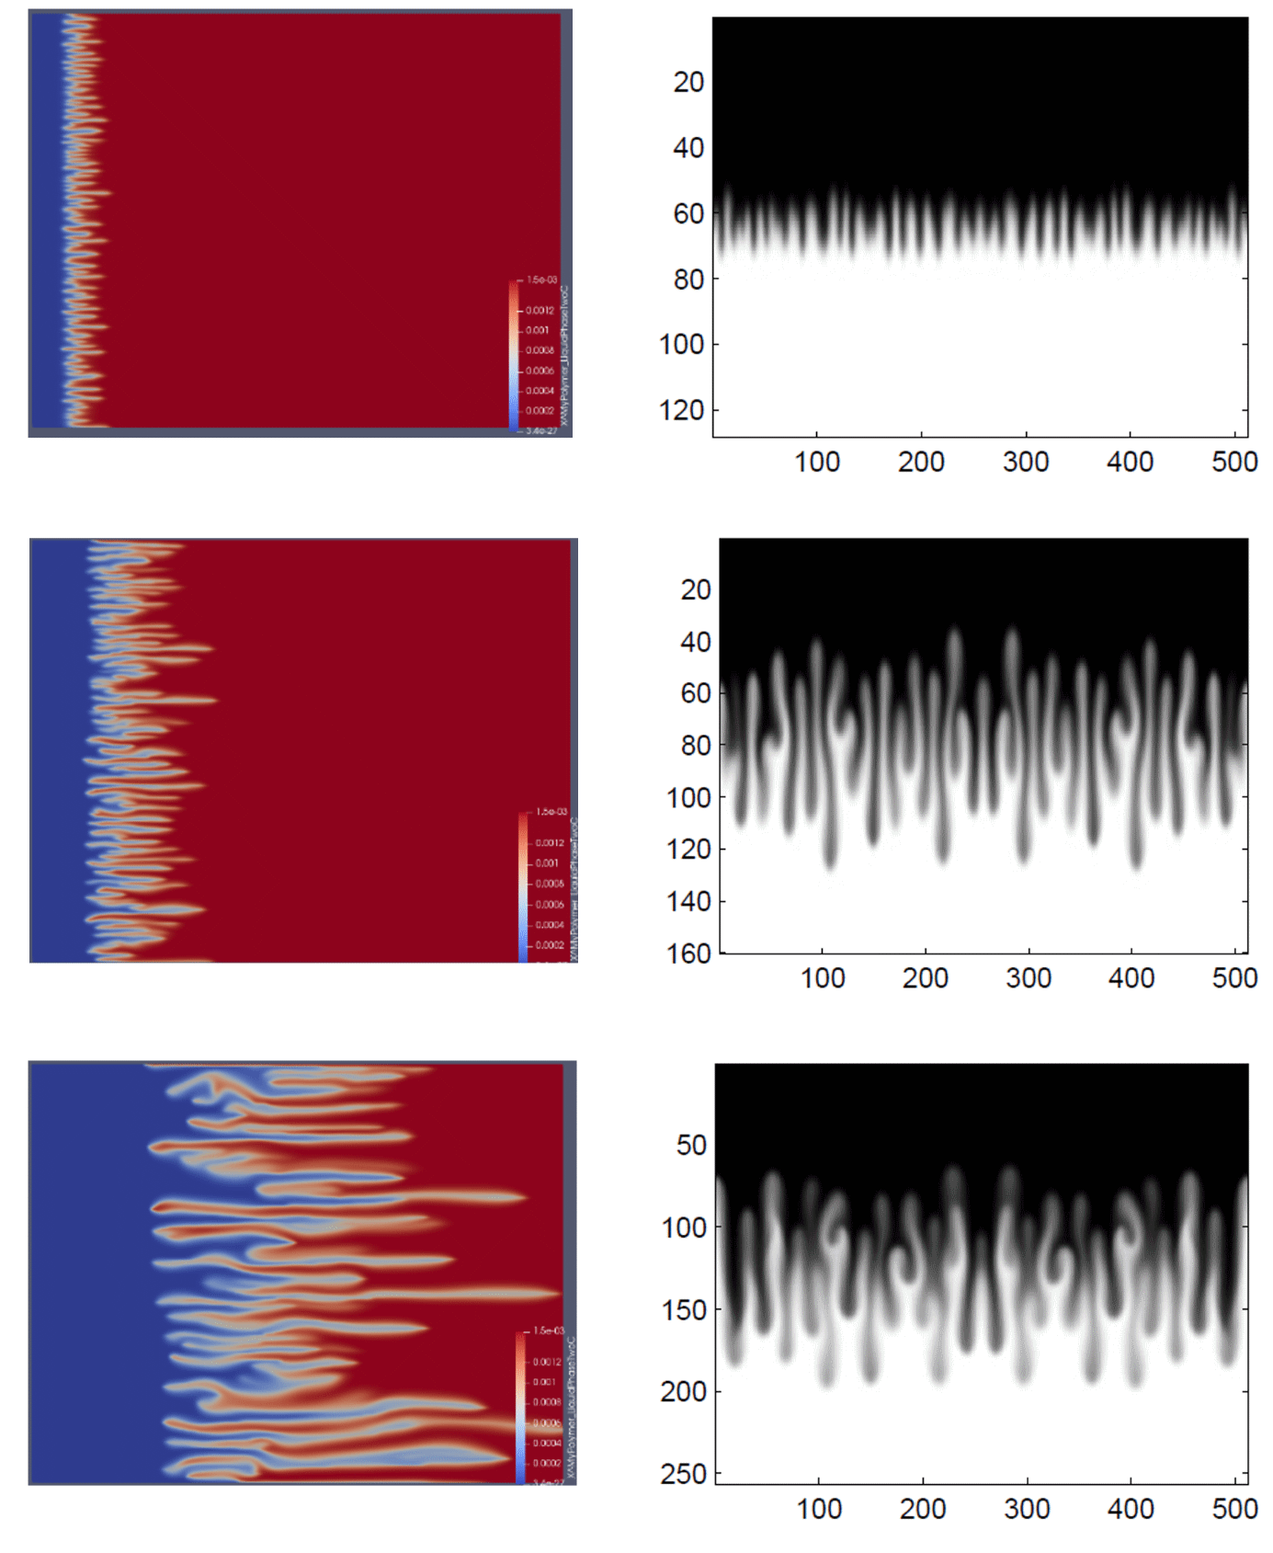
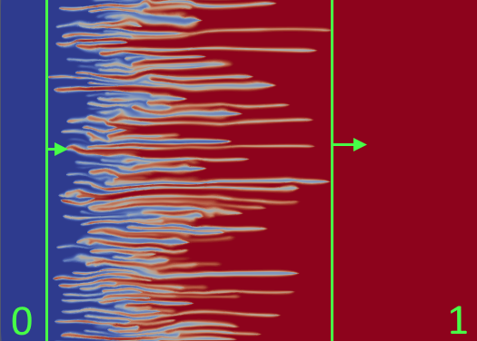
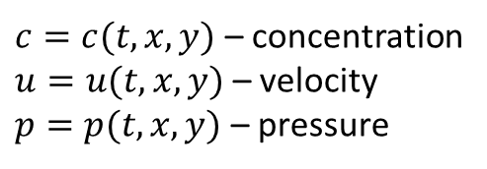
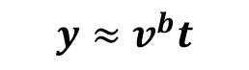
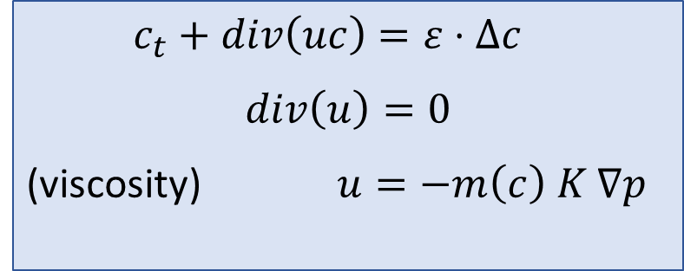



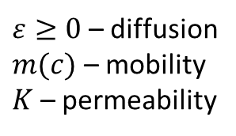
Incompressible Porous Medium eq – IPM, 2D (Two formulations)
Viscous fingering
Gravitational fingering
$c_{t}+div\left(uc\right)=ε⋅Δc$
$$div\left(u\right)=0$$
(viscosity) $u=−m\left(c\right) K ∇p$
1
$$y≈v^{f}t$$
$$x≈v^{b}t$$
$$x≈v^{f}t$$
(gravity) $u=−∇p−(0,c)$
$c=c(t,x,y)$ – concentration
$u=u(t,x,y)$ – velocity
$p=p(t,x,y)$ – pressure
$ε≥0$ – diffusion
$m(c)$ – mobility
$K$ – permeability
-1
$$y≈v^{b}t$$
mixing zone
[1], [2]
many laboratory and numerical experiments show linear growth of the mixing zone
Question: how to find speeds $v^{b}$ and $v^{f}$ of propagation?
[1] Nijjer J., Hewitt D., and Neufeld J. The dynamics of miscible viscous fingering from onset to shutdown. Journal of Fluid Mechanics, 2018.
[2] Bakharev, F., Enin, A., Groman, A., Kalyuzhnyuk, A., Matveenko, S., Petrova, Y., Starkov, I. and Tikhomirov, S., Velocity of viscous fingers in miscible displacement: Comparison with analytical models. Journal of Computational and Applied Mathematics, 2022.
2

Slide 5
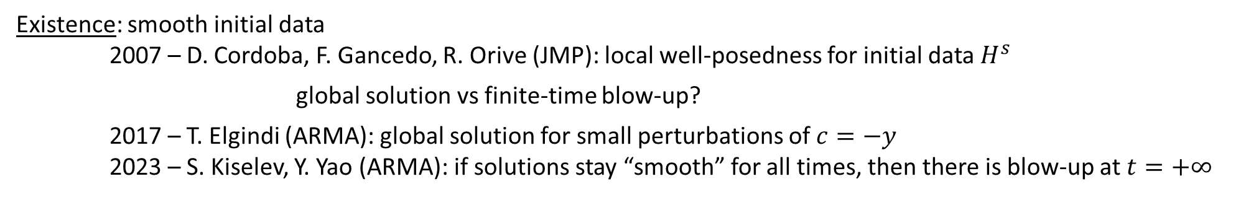
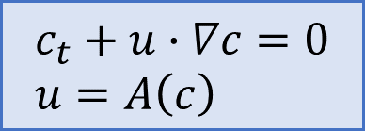
IPM: $ε=0 \text{(}\text{without} \text{diffusion}\text{)}$
$$c_{t}+u∙∇c=0 \\ u=A\left(c\right)$$
Active scalar:
$u=∇^{⊥}{\left(−Δ\right)}^{−1}∂_{1}c$ (Biot-Savart law)
Discontinuous initial data: free boundary problem (Muskat problem) – ill-posed for unstable stratification 2011 - A. Córdoba, D. Córdoba, F. Gancedo (Annals of Mathematics) “Interface evolution: the Hele-Shaw and Muskat problems”
Existence: smooth initial data
2007 – D. Cordoba, F. Gancedo, R. Orive (JMP): local well-posedness for initial data $H^{s}$ global solution vs finite-time blow-up?
2017 – T. Elgindi (ARMA): global solution for small perturbations of $c=−y$
2023 – S. Kiselev, Y. Yao (ARMA): if solutions stay “smooth” for all times, then there is blow-up at $t=+∞$
open
Uniqueness: non-uniqueness of weak solutions – by convex integration
2011 – D. Córdoba, D. Faraco, F. Gancedo (ARMA)
2012 – L. Szekelyhidi Jr.
…and many others…
3

Slide 6
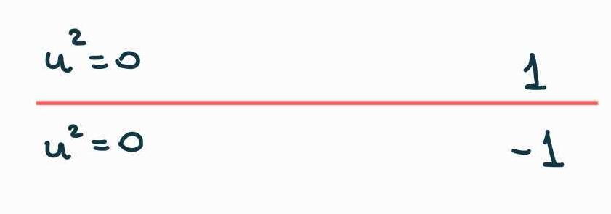
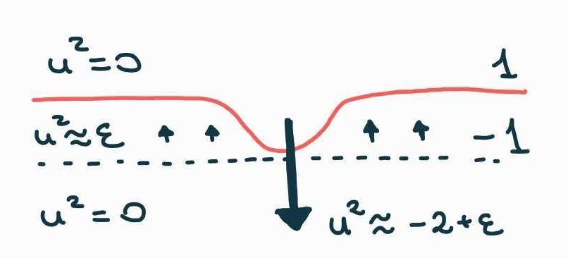
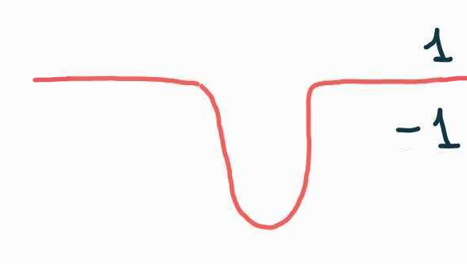
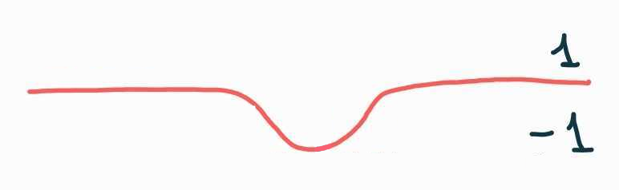
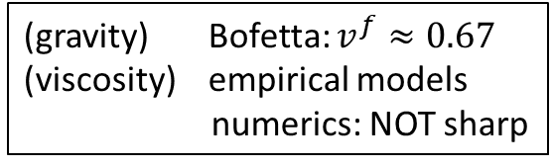
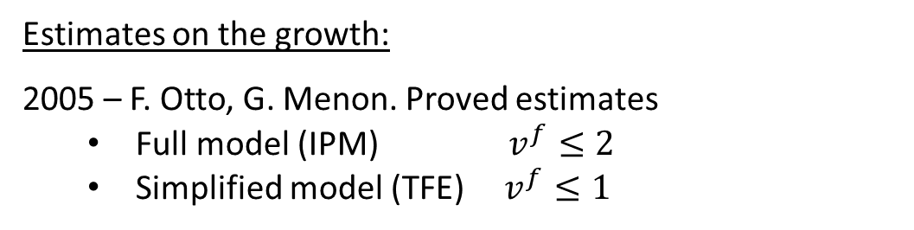
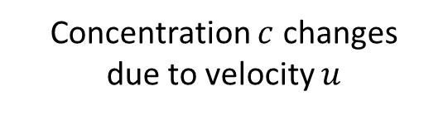
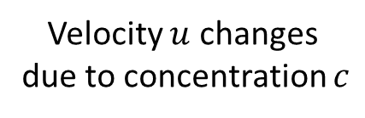
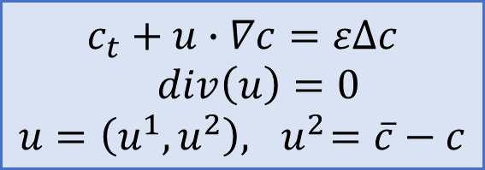
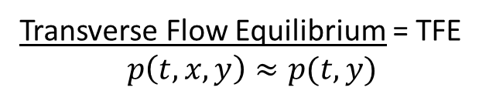
IPM: $ε>0$ (with diffusion)
Question: Are those estimates sharp?
Estimates on the growth:
2005 – F. Otto, G. Menon. Proved estimates
Full model (IPM) $v^{f}≤2$
Simplified model (TFE) $v^{f}≤1$
(gravity) Bofetta: $v^{f}≈0.67$
(viscosity) empirical models numerics: NOT sharp
1
$$y≈v^{f}t$$
$$c_{t}+u∙∇c=εΔc$$
$div\left(u\right)=0$ $$u=\left(u^{1},u^{2}\right), { u}^{2}=\overline{c}−c$$
Transverse Flow Equilibrium = TFE $$p\left(t,x,y\right)≈p(t,y)$$
-1
$$y≈v^{b}t$$
Why fingers appear? It is a hair-trigger effect!
Velocity $u$ changes
due to concentration $c$
Concentration $c$ changes
due to velocity $u$
No flow
4
[2] Bakharev, F., Enin, A., Groman, A., Kalyuzhnyuk, A., Matveenko, S., Petrova, Y., Starkov, I. and Tikhomirov, S., Velocity of viscous fingers in miscible displacement: Comparison with analytical models. Journal of Computational and Applied Mathematics, 2022.
[6] Bakharev F., Enin A., Matveenko S., Rastegaev N., Pavlov D., Tikhomirov S. Relation between size of mixing zone and intermediate concentration in
miscible displacement. arXiv:2310.14260
Neglect advection in transverse direction!

Slide 7
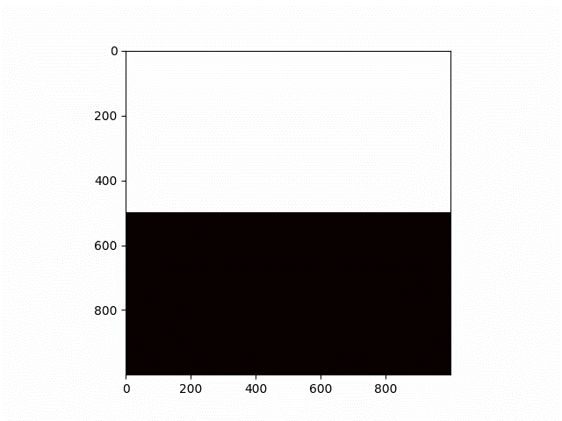
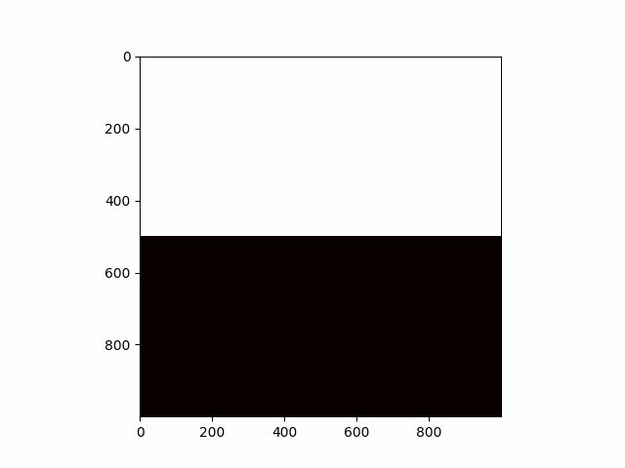
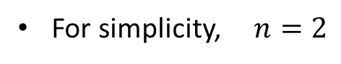
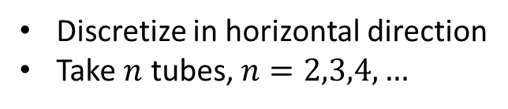
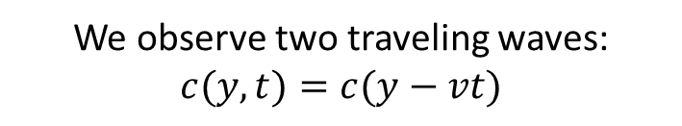
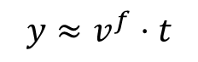
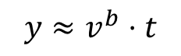
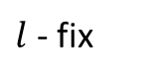

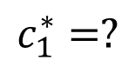
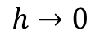
IDEA: semi-discrete model of gravitational fingering
Discretize in horizontal direction
Take $n$ tubes, $n=2,3,4,…$
Limit of
numerical scheme
For simplicity, $n=2$
1
1
$$y≈v^{f}⋅t$$
$$h→0$$
$$c_{1}^{∗}=?$$
$$c_{2}^{∗}=?$$
$$y≈v^{b}⋅t$$
-1
-1
$l$ - fix
Finite volume
Upwind
We observe two traveling waves: $c(y,t)=c(y−vt)$
Tubes (layer, lane,…) models:
1995 — Y. Yortsos “A theoretical analysis of vertical flow equilibrium” 2019 — A. Armiti-Juber, C. Rohde “On Darcy- and Brinkman-type models for two-phase flow in asympt. flat domains”
2006 — J.C. Da Mota, S. Schecter “Combustion fronts in a porous medium with two layers”
2019 — H. Holden, N. Risebro “Models for dense multilane vehicular traffic”
5
2005 – Otto, Menon: pointwise estimates for simplified model

Slide 8
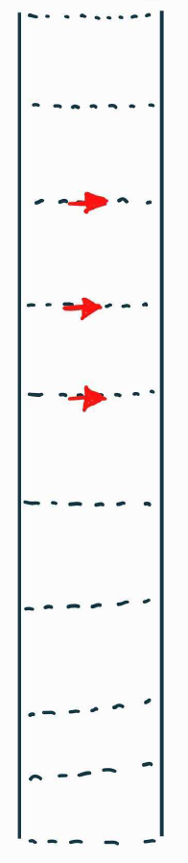
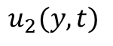
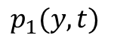
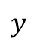

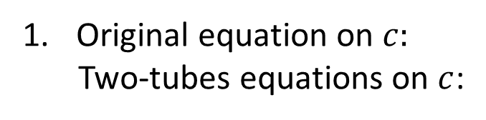
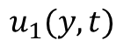
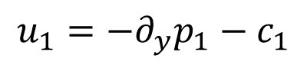
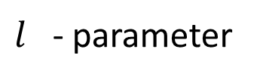
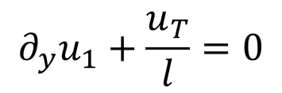
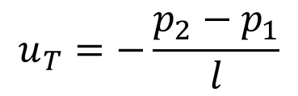
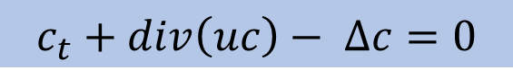
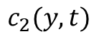
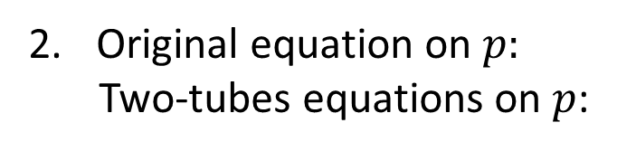
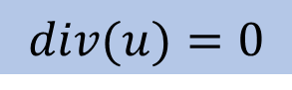
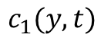







Two-tubes model
Original equation on $c:$
Two-tubes equations on $c$:
$$y$$
$$c_{t}+div\left(uc\right)− ∆c=0$$
$$c_{1}(y, t)$$
$$c_{2}(y, t)$$
$$B$$
$$∂_{t}c_{1}+∂_{y}\left(u_{1}c_{1}\right)−∂_{yy}c_{1}=−B$$
$$∂_{t}c_{2}+∂_{y}\left(u_{2}c_{2}\right)−∂_{yy}c_{2}=+B$$
$$u_{1}(y, t)$$
$$u_{T}(y, t)$$
$$u_{2}(y, t)$$
Original equation on $p:$
Two-tubes equations on $p$:
$$u=−∇p −(0,c)$$
$$p_{1}(y, t)$$
$$p_{2}(y, t)$$
$$u_{1}=−∂_{y}p_{1}−c_{1}$$
$$u_{2}=−∂_{y}p_{2}−c_{2}$$
$l$ - parameter
$$u_{T}=−\frac{p_{2}−p_{1}}{l}$$
$$B=\left\{\left.\begin{aligned}\frac{u_{T}}{l}⋅c_{1}, u_{T}>0, \\ \frac{u_{T}}{l}⋅c_{2}, u_{T}<0\end{aligned}\right.\right.$$
Original equation on $u$:
Two-tubes equations on $u$:
$$div(u)=0$$
$$∂_{y}u_{1}+\frac{u_{T}}{l}=0$$
6

Slide 9







Two-tubes model
Original equation on $c:$
Two-tubes equations on $c$:
$$y$$
$$c_{t}+div\left(uc\right)− ∆c=0$$
$$c_{1}(y, t)$$
$$c_{2}(y, t)$$
$$B$$
$$∂_{t}c_{1}+∂_{y}\left(u_{1}c_{1}\right)−∂_{yy}c_{1}=−B$$
$$∂_{t}c_{2}+∂_{y}\left(u_{2}c_{2}\right)−∂_{yy}c_{2}=+B$$
$$u_{1}(y, t)$$
$$u_{T}(y, t)$$
$$u_{2}(y, t)$$
Original equation on $p:$
Two-tubes equations on $p$:
$$u=−∇p −(0,c)$$
$$p_{1}(y, t)$$
$$p_{2}(y, t)$$
$$u_{1}=−∂_{y}p_{1}−c_{1}$$
$$u_{2}=−∂_{y}p_{2}−c_{2}$$
$l$ - parameter
$$\boxed{\frac{u_{T}}{l}}$$
$$=−\frac{p_{2}−p_{1}}{l^{2}}$$
$$\boxed{\frac{u_{T}}{l}}$$
$$B=\left\{\left.\begin{aligned} \frac{u_{T}}{l} ⋅c_{1}, u_{T}>0, \\ \frac{u_{T}}{l} ⋅c_{2}, u_{T}<0\end{aligned}\right.\right.$$
Original equation on $u$:
Two-tubes equations on $u$:
$$div(u)=0$$
$$\boxed{\frac{u_{T}}{l}}$$
$$\boxed{\frac{u_{T}}{l}}$$
$$∂_{y}u_{1}+ =0$$
6

Slide 10




















Main result
The proof is valid only for $l>0$ sufficiently small
Numerics suggests the same statement for $∀l>0$
Moreover, $\lim_{l→0}{c_{1}^{∗}(l)}=−\frac{1}{2}, \lim_{l→0}{c_{2}^{∗}(l)}=\frac{1}{2}$, $\lim_{l→0}{v^{b}(l)}=−\frac{1}{4}, \lim_{l→0}{v^{f}(l)}=\frac{1}{4}.$
Questions?
$$∂_{t}c_{1}+∂_{y}\left(u_{1}c_{1}\right)− ∂_{yy}c_{1}=−B$$
$$∂_{t}c_{2}+∂_{y}\left(u_{2}c_{2}\right)− ∂_{yy}c_{2}= B$$
$$B=\left\{\left.\begin{aligned}−∂_{y}u_{1}⋅c_{1}, ∂_{y}u_{1}<0, \\ +∂_{y}u_{2}⋅c_{2}, ∂_{y}u_{1}>0\end{aligned}\right.\right.$$
($∗$)
$$u_{1}=−∂_{y}p_{1}−c_{1}$$
Remark:
$$\lim_{l→0}{c_{1}^{∗}\left(l\right)=−0.5}$$
$$\lim_{l→0}{c_{2}^{∗}\left(l\right)=+0.5}$$
$$\lim_{l→0}{v^{b}\left(l\right)=−0.25}$$
$$\lim_{l→0}{v^{f}\left(l\right)=+0.25}$$
$$u_{2}=−∂_{y}p_{2}−c_{2}$$
$$∂_{y}u_{1}=−∂_{y}u_{2}=\frac{p_{2}−p_{1}}{l^{2}}$$
As $t→∞$ we observe:
Theorem (Efendiev, P., Tikhomirov, 2024, arXiv: 2401.05981)
Consider a two-tube model with gravity $(∗)$.
$$1$$
$$c_{2}^{∗}(l)$$
there exists $c_{1}^{∗}(l), c_{2}^{∗}(l)$
$c_{1}$ - blue
$c_{2}$ - green
Then for all $l>0$ sufficiently small
such that there exist two traveling waves (TW):
$$c_{1}^{∗}(l)$$
TW1 with speed $v^{b}(l)$: $\left(−1, −1\right) → \left(c_{1}^{∗},(l) c_{2}^{∗}(l)\right)$ TW2 with speed $v^{f}\left(l\right)$: $\left(c_{1}^{∗},(l) c_{2}^{∗}(l)\right) → \left(1, 1\right).$
$$−1$$
7

Slide 11




Many tubes: numerics
The proof is valid only for $l>0$ sufficiently small
Numerics suggests the same statement for $∀l>0$
Moreover, $\lim_{l→0}{c_{1}^{∗}(l)}=−\frac{1}{2}, \lim_{l→0}{c_{2}^{∗}(l)}=\frac{1}{2}$, $\lim_{l→0}{v^{b}(l)}=−\frac{1}{4}, \lim_{l→0}{v^{f}(l)}=\frac{1}{4}.$
3 tubes
4 tubes
7 tubes
Questions:
(open)
(1) explain the structure of “asymptotic solutions” for $n$ tubes and study their stability
(2) find speed of growth of the mixing zone
(3) understand the behaviour as $n→∞$. Do we approximate 2-dim IPM?
(4) can we repeat this story for the many tubes viscous fingering model?
8

Slide 12









Scheme of proof: step 1 - TW
СПАСИБО за внимание! Приезжайте в гости в Рио-де-Жанейро!
System of ODEs in $ℝ^{6}$:
Travelling wave (TW) ansatz with fixed $v$:
$$c_{1}\left(t,y\right)=c_{1}\left(y−vt\right)$$
$$c_{2}\left(t,y\right)=c_{2}\left(y−vt\right)$$
$$u_{1}\left(t,y\right)=u_{1}\left(y−vt\right)$$
$$u_{2}\left(t,y\right)=u_{2} \left(y−vt\right)$$
$$p_{1}\left(t,y\right)=p_{1}\left(y−vt\right)$$
$$p_{2}\left(t,y\right)=p_{2}(y−ct)$$
$$\left\{\begin{aligned} \dot{X}=F_{v}(X,Y) \\ l⋅\dot{Y}=AY−BX\end{aligned}\right.$$
Here:
$X=\left(\begin{aligned}\begin{aligned}c_{1} \\ c_{2} \\ ∂_{ξ}c_{1}\end{aligned} \\ ∂_{ξ}c_{2}\end{aligned}\right)∈ℝ^{4}$, $Y=\left({u_{1} \atop p_{1}−p_{2}}\right)∈ℝ^{2}$
$A=\left(\begin{matrix}0 & 1 \\ 2 & 0\end{matrix}\right)$, $B∈M^{2×4}$, $l≪1$
With condition at $+∞:$
$$c_{1}\left(+∞\right)=1$$
$$c_{2}\left(+∞\right)=1$$
$$u_{1}\left(+∞\right)=0$$
$$u_{2}\left(+∞\right)=0$$
$$\left(p_{1}−p_{2}\right)\left(+∞\right)=0$$
Observation:
for $l→0$this system has a special ``slow-fast’’ structure. Key tool: geometric singular perturbation theory (GSPT) by Fenichel (JDE, 1979)
Aim: $∀v$ $∃$TW
find a heteroclinic orbit $\left(X\left(ξ\right),Y\left(ξ\right)\right), ξ∈ℝ$ such that $\left(X\left(+∞\right), Y\left(+∞\right)\right)=$ given point.
9

Slide 13







Scheme of proof: step 2 – cascade of 2 TW
1) For each $v^{f}∈ℝ$ we find all points s.t. there exists a TW:
$$\left(c_{1} ,c_{2}\right) → \left(1, 1\right)$$
2) For each $v^{b}∈ℝ$ we find all points s.t. there exists a TW:
$$\left(−1, −1\right)→\left(c_{1} ,c_{2}\right)$$
3) Find the intersection points of these two curves
$l=0$ – these curves are just straight lines
$0<l≪1$– perturbation argument
10

Slide 14










But what is a singular limit $l=0?$
$$∂_{t}c_{1}+∂_{y}\left(u_{1}c_{1}\right)− ∂_{yy}c_{1}=−B$$
$$∂_{t}c_{2}+∂_{y}\left(u_{2}c_{2}\right)− ∂_{yy}c_{2}= B$$
$l=0$corresponds to the
two-tubes TFE equations (**) !!!
($∗∗$)
$$u_{1}=\frac{c_{2}+c_{1}}{2}−c_{1}=\overline{c}−c_{1}$$
NB: (**) can be seen a hyperbolic system in non-conservative form (for fixed choice of B):
$$B=\left\{\left.\begin{aligned}−∂_{y}u_{1}⋅c_{1}, ∂_{y}u_{1}<0, \\ +∂_{y}u_{2}⋅c_{2}, ∂_{y}u_{1}>0\end{aligned}\right.\right.$$
$$C_{t}+A\left(C\right)C_{y}=0$$
Question:
(open)
TFE as a limit of IPM as $k_{y}/k_{x}→∞$? Can we use the connection to prove the linear growth in 2D IPM?
$$C(0,y)=\left\{\begin{aligned}\left(+1,+1\right), y>0 \\ &(−1,−1), y≤0\end{aligned}\right.$$
Use vanishing viscosity criteria to define admissible shocks
For 2 and 3 tubes this is a “Temple-like” system (rarefaction and shock curves coincide and are linear)
2D IPM model
$$c_{t}+u∙∇c= ε ∆c \\ div u=0 \\ u=−\left(\begin{matrix}k_{x} & 0 \\ 0 & k_{y}\end{matrix}\right) ∇p−(0, c)$$
$$\frac{k_{y}}{k_{x}}→∞$$
2D TFE model
$$c_{t}+u∙∇c= ε ∆c \\ div u=0 \\ u=\left(u^{x}, u^{y}\right)$$ $u^{y}= \overline{c}−c$
11

Slide 15

Thank you for your attention! Muito obrigada! ¡Muchas gracias!
yu.pe.petrova@gmail.com
https://yulia-petrova.github.io/
For more details see arXiv:2401.05981 (two-tubes model)
Any questions, comments and ideas are very welcome!
12

Slide 16
References
Muito obrigada pela atenção!
Own works on the topic of the talk:
Yu. Petrova, S. Tikhomirov, Ya. Efendiev, “Propagating terrace in a two-tubes model of gravitational fingering” Submitted. ArXiv: 2401.05981; 2024.
Bakharev, F., Enin, A., Groman, A., Kalyuzhnyuk, A., Matveenko, S., Petrova, Yu., Starkov, I. and Tikhomirov, S., “Velocity of viscous fingers in miscible displacement: Comparison with analytical models”. Journal of Computational and Applied Mathematics, 402, p.113808; 2022.
Bakharev, F., Pavlov D., Enin, A., Matveenko, S., Petrova, Yu., Rastegaev N., and Tikhomirov, S., “Velocity of viscous fingers in miscible displacement: Intermediate concentration” Journal of Computational and Applied Mathematics, 451:116107, 2024.
Other references: Dynamics of viscous fingering:
Nijjer J., Hewitt D., and Neufeld J. The dynamics of miscible viscous fingering from onset to shutdown. Journal of Fluid Mechanics 837 (2018): 520-545.
Menon, G. and Otto, F., 2006. Diffusive slowdown in miscible viscous fingering. Communications in Mathematical Sciences, 4(1), pp.267-273.
Menon, G. and Otto, F., 2005. Dynamic scaling in miscible viscous fingering. Communications in mathematical physics, 257, pp.303-317.
Homsy, G.M., 1987. Viscous fingering in porous media. Annual review of fluid mechanics, 19(1), pp.271-311.

Slide 17
References
Muito obrigada pela atenção!
Geometric singular perturbation theory (GSPT):
Fenichel, N., 1979. Geometric singular perturbation theory for ordinary differential equations. Journal of differential equations, 31(1), pp.53-98.
Wechselberger, M., 2020. Geometric singular perturbation theory beyond the standard form (Vol. 6). New York: Springer.
Kuehn, C., 2015. Multiple time scale dynamics (Vol. 191). Berlin: Springer.
Well-posedness for IPM:
Kiselev, A. and Yao, Y., 2023. Small scale formations in the incompressible porous media equation. Archive for Rational Mechanics and Analysis (ARMA), 247(1), p.1.
A. Castro, D. Cordoba and D. Lear, Global existence of quasi-stratified solutions for the confined IPM equation, Archive for Rational Mechanics and Analysis (ARMA), 232 (2019), no. 1, 437–471.
T. Elgindi, On the asymptotic stability of stationary solutions of the inviscid incompressible porous medium equation, Archive for Rational Mechanics and Analysis (ARMA), 225 (2017), no. 2, 573–599.
Non-uniqueness for IPM:
D. Cordoba, D. Faraco and F. Gancedo, Lack of uniqueness for weak solutions of the incompressible porous media equation, Archive for Rational Mechanics and Analysis (ARMA) 200 (2011), no. 3, 725–746.
Shvydkoy, R.: Convex integration for a class of active scalar equations. J. Am. Math. Soc. 24(4), 1159–1174 (2011).
L. Szekelyhidi, Jr. Relaxation of the incompressible porous media equation, Ann. Sci. de l’Ecole Norm. Superieure (4) 45 (2012), no. 3, 491–509.

